Slide 1
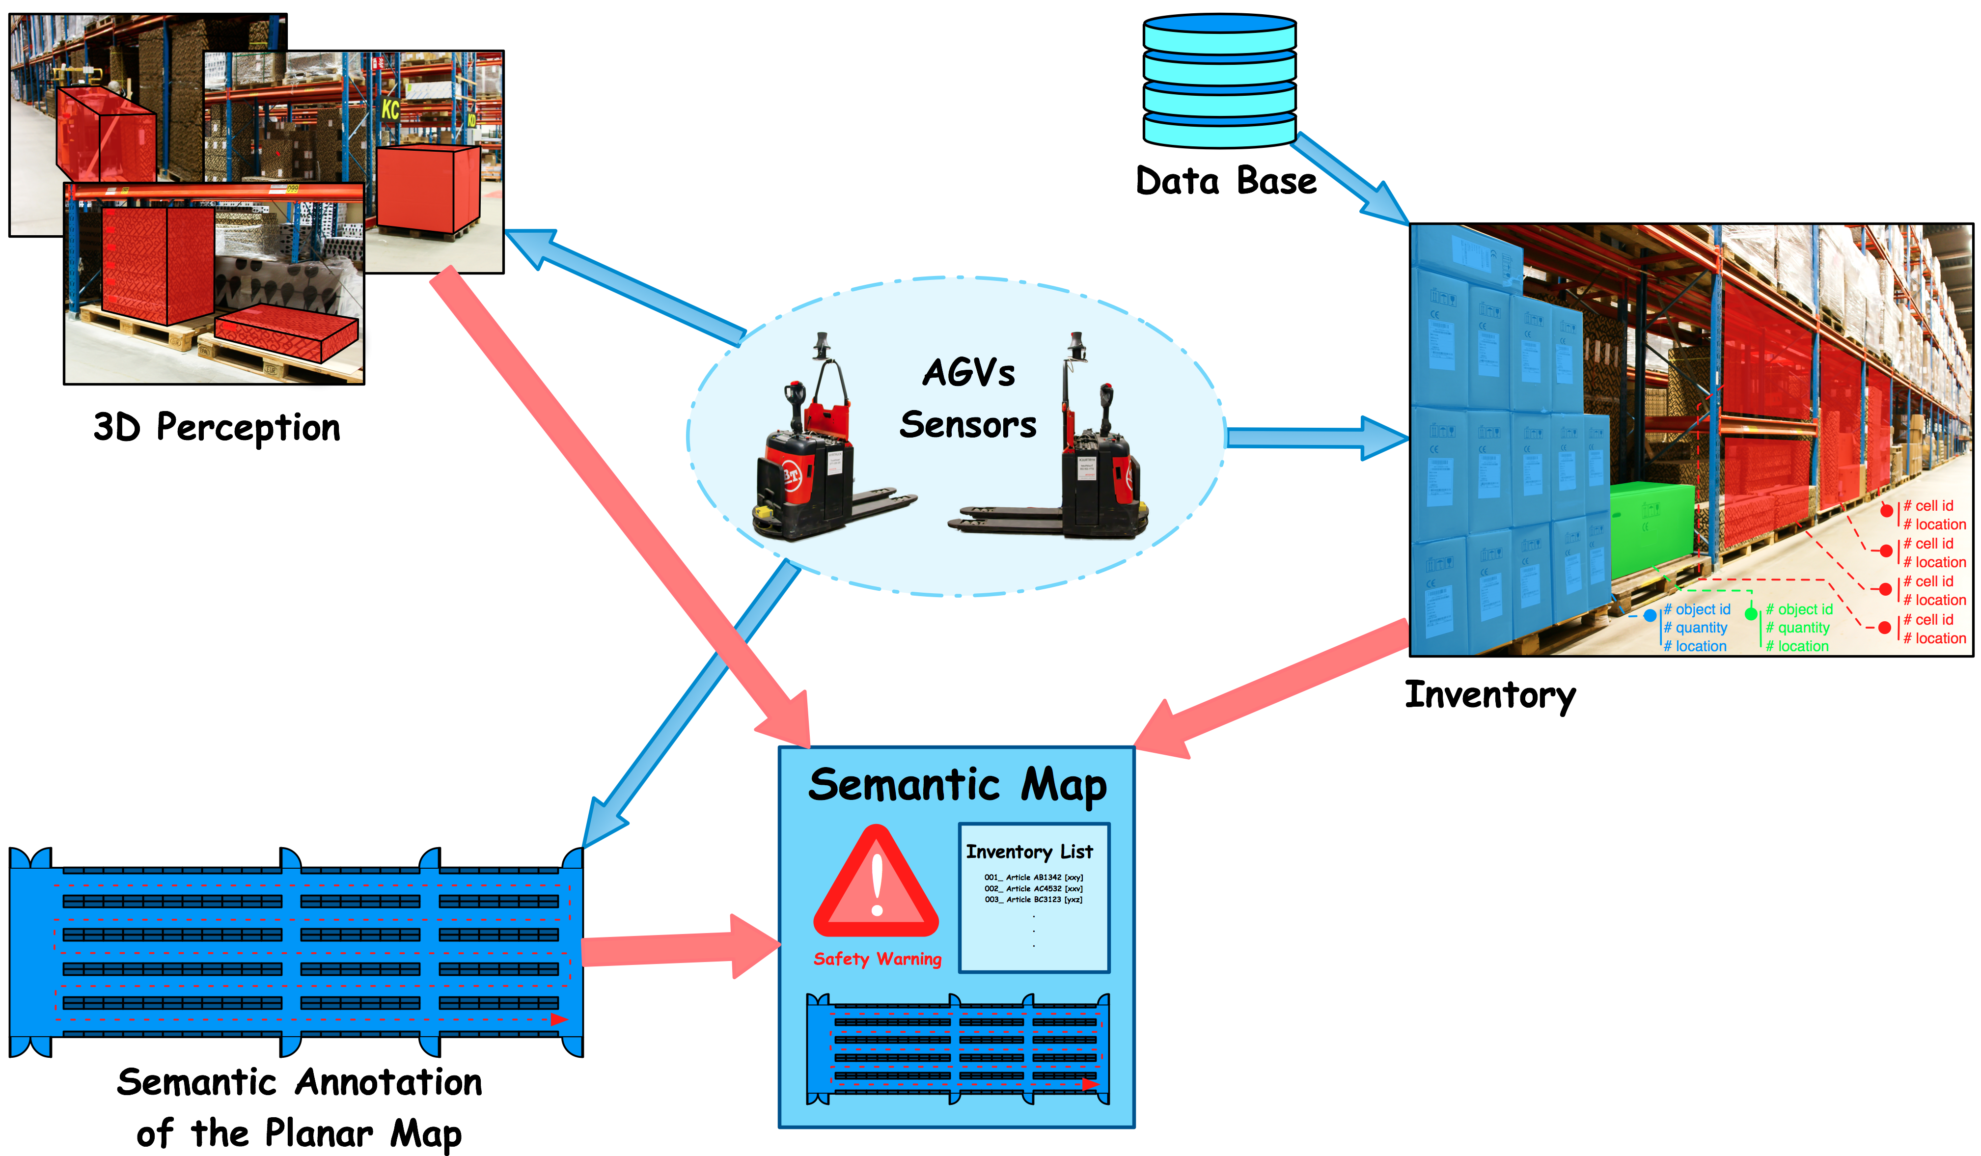
Automatic Inventory and Mapping of Stock (AIMS)
Overall Goal: An intelligent warehouse environment that autonomously builds a map of stock articles, and relates article identity from the database of the management system with the article’s position (metric) and visual appearance in the environment.
Motivation - Important skills for future robots and automated guided vehicles (AGV's) are:
  The ability to recognize and describe objects that the robot shall handle and the environment in which it operates (situation awareness).
  The ability to structure and sort information provided by sensors (flexibility and adaptability).
Objective:
  Mapping and semantic anonnation.
  Inventory list maintainance.
  3D perception.
Planar Semantic Mapping: A geometric-topological model of the environmentis developed relying on the geometric characteristics of maps, annotated with semantic labels. Such a map is supposedly carries the knowledge needed for intelligent warehouses.
Geometric Semantic Modelling of Infrastructure
Semi-Supervised Semantic Modelling
Inventory List Maintenance: An inventory list of stored articles in the environment will be extracted from vision sensors, such as a camera for identification and 3D sensor for volum estimation. This stage is under developement and will rely on techniques from computer vision for represention of the sensory data, machine learning for semi-supervised object recognition and data mining for knowledge discovery.
Publications:
[1] S. Gh. Shahbandi, B. Åstrand and R. Philippsen, Semi-Unsupervised Place Categorization for Semantic Labeling of Adaptive Cell Decomposition Maps, ECMR 15, 2015
[2] S. Gh. Shahbandi, B. Åstrand and R. Philippsen, Sensor based adaptive metric-topological cell decomposition method for semantic annotation of structured environments, Proceedings of the ICARCV 14, Singapore, December 10-12, 2014
[3] S. Gh. Shahbandi and B. Åstrand, Modeling of a large structured environment, TAROS 14, Birmingham, Britain, September 1-3, 2014
{ 2015 July}
Industial Partners:
Kollmorgen, Optronic and
Toyota Material Handling Europe
Contacts:
Björn Åstrand
Saeed Gholami Shahbandi

